Slide 1


Quantum Computing: Climate Change Modeling and Mitigation
Quantum computing holds immense potential in addressing the complex challenges posed by climate change. By harnessing the unique properties of quantum mechanics, this revolutionary technology can simulate climate systems, model climate patterns, and optimize mitigation strategies with unprecedented speed and accuracy.
by Misha Ganji
(22071A6716- CSE-DS-A)

Slide 2

What is Quantum Computing?
1
Quantum Mechanics
2
Qubits
Quantum computing leverages the principles of quantum mechanics, where particles can exist in multiple states simultaneously.
The fundamental units of quantum computing, qubits, can represent 0, 1, or a superposition of both states.
3
Parallelism
Quantum computers can perform multiple calculations simultaneously, offering exponential speedups over classical computers.

Slide 3
Advantages of Quantum Computing
Speed
Complexity
Optimization
Quantum computers can solve certain problems exponentially faster than classical computers, enabling rapid analysis and decision-making.
Quantum systems can simulate and model highly complex problems, such as the intricate dynamics of climate systems.
Quantum algorithms can help optimize solutions for climate change mitigation strategies, leading to more efficient and effective interventions.

Slide 4

Applications of Quantum Computing
Climate Modeling
Material Science
Quantum computers can simulate complex climate systems with greater accuracy and speed, enabling better predictions and mitigation strategies.
Quantum computing can help design new materials and technologies for renewable energy production and storage.
Optimization
Cryptography
Quantum algorithms can optimize logistics, transportation, and resource allocation to reduce carbon footprint and environmental impact.
Quantum-resistant cryptography can secure communication and data related to climate change research and mitigation efforts.

Slide 5

Climate Change Modeling using Quantum Computing
1
Simulating Climate Systems
Quantum computers can model the intricate interactions between the atmosphere, oceans, and land, providing more accurate climate predictions.
2
Forecasting Weather Patterns
Quantum algorithms can analyze vast amounts of meteorological data to improve short-term and long-term weather forecasting.
3
Analyzing Climate Feedback Loops
Quantum computing can help identify and quantify the complex feedback mechanisms that drive climate change, enabling more effective interventions.

Slide 6
Simulating Complex Climate Systems
Atmospheric Dynamics
Ocean-Atmosphere Interactions
Biogeochemical Cycles
Quantum computers can simulate the intricate movements of air masses, currents, and weather phenomena that shape climate patterns.
Quantum simulations can help understand the flow of carbon, nitrogen, and other essential elements through the climate system.
Quantum-powered models can capture the complex interplay between ocean temperatures, currents, and atmospheric conditions.

Slide 7
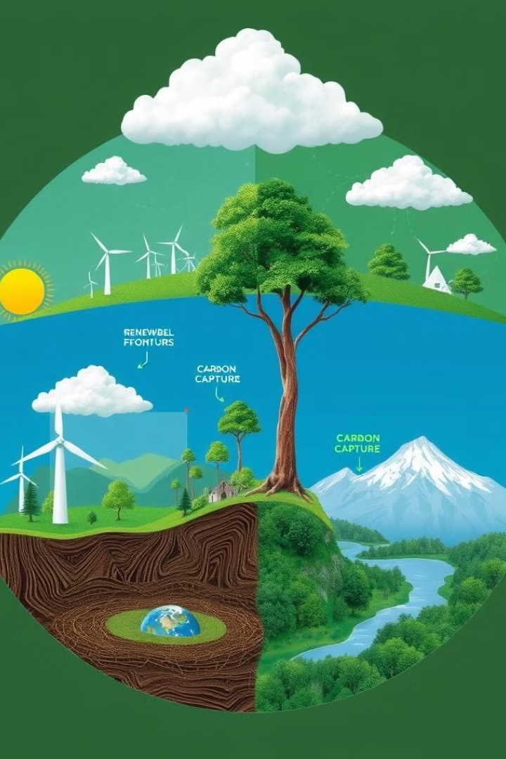



Optimizing Climate Change Mitigation Strategies
Renewable Energy
Quantum computing can help optimize the design, placement, and operation of renewable energy systems for maximum efficiency and impact.
Carbon Capture
Quantum algorithms can streamline the development and deployment of carbon capture and sequestration technologies.
Land Use Optimization
Quantum-powered models can identify the most effective strategies for reforestation, land management, and sustainable agriculture.

Slide 8





The Future of Quantum Computing in Climate Change
Computational Power
Deeper Insights
As quantum computers continue to evolve, their ability to simulate and model complex climate systems will become increasingly powerful.
Quantum computing will enable more detailed and accurate analysis of climate data, leading to better understanding and mitigation strategies.
Optimization Potential
Global Collaboration
Quantum algorithms will revolutionize the optimization of climate-friendly technologies, infrastructure, and policies.
The development and application of quantum computing for climate change will require international cooperation and knowledge-sharing.

Slide 9

Current Limitations of Quantum Computing in Climate Research
Hardware Maturity: Quantum computers face challenges like qubit instability and error correction, limiting their current capabilities.
Scalability: Present quantum systems have a limited number of qubits, requiring significant advancements to handle large-scale tasks like climate modeling.
Classical-Quantum Integration: Quantum computers will work alongside classical systems in hybrid models for the foreseeable future, rather than replacing them.

Slide 10


